Slide 1
CommScope: Remediation Engagement
Internal Kickoff

Slide 2
Agenda
Mandiant Team
Recap of CommScope engagement – Phase 1
Phase 2:
SoW Review/Status
Six Streams
Current Status
Mandiant Meeting Schedules
Expectations / Commitments / Timeline
Next Steps
Mandiant Proprietary and Confidential

Slide 3
Mandiant Team
IR
Howard Israel
??
STS
CPA
Jegan Candassamy
Blake Renaud
Andy Tomaszewski
Roshini Jagadam
Thomas Fernandes
Kyle Chrzanowski
Michael Helman - Principal Consultant
Brian Meyer - Principal Consultant
Marisa Dyer - Senior Consultant
Steven Godofsky - Consultant
Tad Miller - Senior Consultant
ADSA and Azure/M365 Security Assessment:
PM:
Justin Cameron - Project Manager
Mandiant Proprietary and Confidential

Slide 4
CommScope Recap

Slide 5

Attack Lifecyle
February – March 2023
Domain Discovery
Collection of NTDS.dit and security hives*
March 11, 2023
Use of collected credentials
March 11, 2023
Escalate Privileges
Internal Reconnaissance
Initial Recon
Initial Compromise
Establish Foothold
Complete Mission
Move Laterally
Maintain Presence
Discovery of Attack Surface Area.
Feb 22.2023
Account compromise
Single Factor Authenticated Remote login to Citrix
March 8, 2023
Kerberoasting
March 8, 2023
Data collections / Data exfil (w.ps1)
Data encryption/ransomware (ESXi hypervisors)
March 26, 2023
Move to ARRS domain
March 9, 2023
Install backdoor
March 9, 2023
*Attacker performed the cycle of credential harvesting on 4 domains (ARRS, CommScope, MFG, USA)
Mandiant Proprietary and Confidential

Slide 6
Summary of Mitigation and Hardening
CommScope information security took the following mitigation and environmental hardening procedures to contain, eliminate, and prevent the threat actors continued activities:
Reset all user and service credentials
Reset the Kerberos Account (KRBTGT), twice
Create all new privileged user or service accounts
Enable Multi-Factor authentication for all users, all access points
Block known threat actor IP addresses at the firewalls
Block execution of known host-based Indicators of Compromise (IOC) within the deployed EDR, SentinelOne
Deploy addition security tools, Trellix HX, to all systems and enable Mandiant Managed Defense services
Rebuild/Restore Microsoft Active Directory architecture to a known good state
Apply hardening polices to the new Microsoft Active Directory architecture
Rebuild VMWare ESXi hypervisors, apply hardening polices
Mandiant Proprietary and Confidential

Slide 7
Lesson Learned
Key areas of improvement for CommScope Cyber Security Program
Global use of Multi-Factor Authentication on all systems
Standardized log collection
Standardized security tool configurations / processes / procedures
EDR
Firewall (IPS/IDS)
Maturing of Security Team
Education and Training for security professionals on documented defense tools, techniques and procedures
Documented and current SOC plans / playbooks / procedures
Mandiant Proprietary and Confidential

Slide 8
Remediation Charter
Subhead can go here

Slide 9
CommScope SoW
Active Directory Security Assessment ​
Build a profile of CommScope’s Active Directory (AD) environment​
Review current controls​
Identify strategies to mitigate impacts or risks​
Includes interactive, remote workshops​
Deliverables include a report, executive summary, and technical presentation​
Microsoft Azure and Microsoft 365 Security Assessment ​
Assesses the management structure, operational framework and controls in place ​
Includes a review of policies, standards, configurations, and procedures supporting the in-scope Microsoft Azure and Microsoft 365 subscription(s)​
Includes interactive, remote workshops​
Deliverables include a report, executive summary, and technical presentation​
SOC Management and Advisory Services​
Serve as a fully dedicated Interim Security Manager overseeing the Security Operations Center (SOC).​
SOC Portfolio Review​
Activity 1: Kickoff Meeting/Documentation Collection and Analysis ​
Activity 2: Interactive Workshop and Meetings
Mandiant Proprietary and Confidential

Slide 10
CPA Charter Overview
CommScope has many cybersecurity projects in flight
Managing the projects, monitoring project status, and achieving meaningful progress is their primary issue
Make work visible
Project status reporting to their SLT
AzureDevOps (ADO) is the chosen project tracking tool
SIX work-streams
Mandiant Proprietary and Confidential

Slide 11
SIX Work Streams
WS1: Identity & Access Management
WS2:Cyber Security
WS3: Infrastructure Security
WS4:Data Security
WS5:Product Security
WS6:Other Security Initiatives
Privileged Access Management (PAM)
MFA Hardening
Active Directory Hardening
Migrate SentinelOne to CrowdStrike
Optimize managed Detection and Response
Optimize Vulnerability Management
Implement Cyber Fusion Center
Cyber Operations Optimizations
N/w Firewalls-Palo Alto Project
FBI-DHS CISA for threat intelligence
Sunset End of Life Hardware and Software
Citrix Hardening
VMWare
RedHat + Satellite
Storage
Network / Site Segmentation
Network Access Control Project
Guess Wireless – CloudPath
Network Access Control
Network-Firewalls Segmentation
CloudOps
Site Segmentation – NCCL
CommVault
Enhance Security for Legal L – Drive
Sensitive Data Management
Data Classification
Data Loss Prevention
Enhance Security for Finance team shared drive
Web Application Firewalls
Product Security Standards and Tools
Bug Bounty / Product Security Responses
CIS-18 Control Framework Assessment (PWC)
Notes:
At Mandiant, we partner with our customers to:
Improve cyber risk readiness and resilience
We want to help you enhance your security posture through proactive testing and measurement of controls against the latest threats.
Drive efficient and effective security operations
So you can reduce the cost of security operations and improve operational effectiveness.
Reduce the business impact of a breach
By accelerating your response and minimizing the impact of a security breach, thus protecting your critical assets, brand value, and reputation against known and continually evolving threats.

Slide 12
Current Status
Backlog
Ready
InProgress
Done
Accepted
Show all work in CommScope ADO instance
Validate everyone’s access to Azure DevOps (ADO)
Align on engagement expectations and next steps
Configure ADO for use with this engagement
Load assessment steps into ADO
Get teams familiar with ADO
Load client’s internal work into ADO
Develop assessment results as backlog in ADO
Start showing work in CommScope ADO instance
Write Charters for all potential work
Mandiant Proprietary and Confidential

Slide 13
Proposed Meeting Schedule
Monday | Tuesday | Wednesday | Thursday | Friday
Daily Standup (30 Minutes) Capacity Planning?? (30 minutes) | Daily Standup (30 Minutes) Release Planning?? (1 hour) | Daily Standup (30 Minutes) Backlog Refinement?? (1 hour) | Daily Standup (30 Minutes) Leadership Status Meeting?? (1 hour) | Daily Standup (30 Minutes)
Daily Standup
Attendees: Core + CPA Team
Agenda: Discuss roadblocks, Inhibitors, changes to AC
Capacity Planning
Attendees: Core Team
Agenda: Capture changes in availability, estimates, assign work category
Release Planning
Attendees: PMO/Governance Team
Agenda: Define release goal, prioritize work, set dates, & validate charter
Backlog Refinement
Attendees: Core/Governance Team
Agenda: Refine stories, estimate effort, resolve dependencies, prioritize work
Leadership Status Meeting
Attendees: Delivery Team & Leadership
Agenda: Status review, challenges, priorities & decisions
Week 1 | Week 2 | Week 3 | Week 4
 |  | Project Stakeholder Meeting (1 hour) | Cyber Steering Committee Meeting (1 hour)
Project Stakeholder Meeting
Attendees: CommScope & Mandiant Stakeholders
Agenda: Discuss status of Mandiant deliverables as defined in the SOW
Steering Committee Meeting
Attendees: Steering Committee & Leadership
Agenda: Discuss status of project relative to project charter definitions
Mandiant Proprietary and Confidential

Slide 14
Standup Meeting Overview
Currently scheduled Mon, Tue, Wed, Thu and Fri at 9AM Eastern
Objectives
Review the ADO Kanban board in order to share and discuss:
Daily updates and progress
Next steps and priorities
New or persistent risks, issues, or blockers
Things that could be brought up.
Information/updates from CommScope that could be useful to the team.
Escalations
Resourcing requirements/challenges
Changes in priority
Mandiant Proprietary and Confidential

Slide 15
Timeline
Set Expectations / Near Term Commitments
July 5
July 24
Date
Date
Date
Date
Mandiant internal kickoff
ADSA and M365 Sec Assessment
15

Slide 16
Next Steps
CAPTURE NEXT STEPS:
Mandiant Proprietary and Confidential

Slide 17
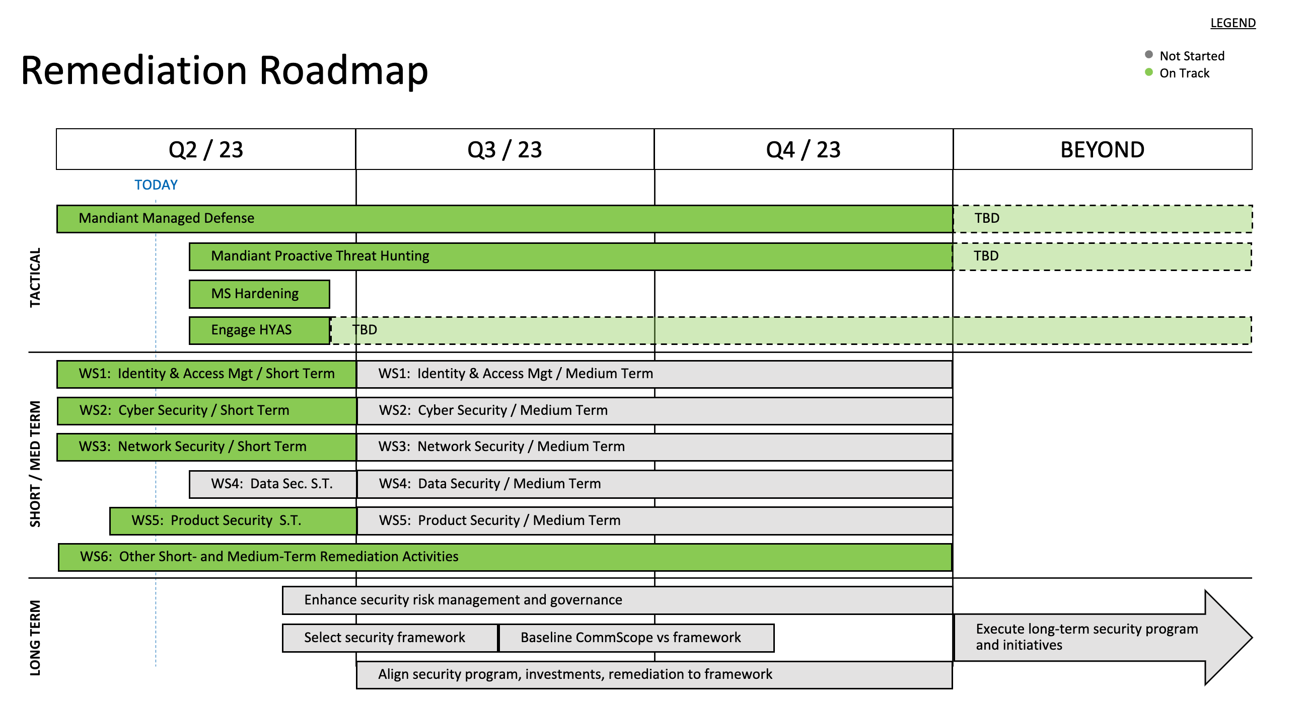
Backup slides
Taken from a deck that was presented in May '23
Mandiant Proprietary and Confidential

Slide 18
Thank You

